Slide 1
Department of Computer Science & Engineering
I Year CSE II Sem
Subject: Adaptive Computer Technologies(MR22-1ES0103)
Prepared by
Vikram Kalvala
Asst.Prof.

Slide 2
Unit 3- Cloud & IOT
Cloud Computing:
Trends in Computing – Distributed Computing, Grid Computing, Cluster Computing, Utility Computing,
Cloud Computing, Definition of Cloud Computing, Characteristics, Service Models, Deployment Models, Cloud Service Models Providers.
Advantages and Disadvantages of Cloud Computing,
Cloud-based Services & Applications.
The Internet of Things:
• An Overview - IoT Reference model and Architecture
• The Things in IoT : Sensors and Actuators
• Sensor fundamentals and characteristics–Principles of sensing capacitance-magnetic and electromagnetic induction–resistance- piezoelectric effect–heat transfer- light.
• Applications of IOT and Sensors.

Slide 3
Trends in Computing
Distributed Computing, Grid Computing, Cluster Computing, Utility Computing.
What is Distributed Computing?
Distributed computing refers to a system where processing and data storage is distributed across multiple devices or systems, rather than being handled by a single central device. In a distributed system, each device or system has its own processing capabilities and may also store and manage its own data. These devices or systems work together to perform tasks and share resources, with no single device serving as the central hub.
One example of a distributed computing system is a cloud computing system, where resources such as computing power, storage, and networking are delivered over the Internet and accessed on demand. In this type of system, users can access and use shared resources through a web browser or other client software.

Slide 4
Distributed Computing
Components:
There are several key components of a Distributed Computing System
Devices or Systems: The devices or systems in a distributed system have their own processing capabilities and may also store and manage their own data.
Network: The network connects the devices or systems in the distributed system, allowing them to communicate and exchange data.
Resource Management: Distributed systems often have some type of resource management system in place to allocate and manage shared resources such as computing power, storage, and networking.
The architecture of a Distributed Computing System is typically a Peer-to-Peer Architecture, where devices or systems can act as both clients and servers and communicate directly with each other.

Slide 5
Distributed Computing
Advantages:
Scalability: Distributed systems are generally more scalable than centralized systems, as they can easily add new devices or systems to the network to increase processing and storage capacity.
Reliability: Distributed systems are often more reliable than centralized systems, as they can continue to operate even if one device or system fails.
Flexibility: Distributed systems are generally more flexible than centralized systems, as they can be configured and reconfigured more easily to meet changing computing needs.
Limitations:
Complexity: Distributed systems can be more complex than centralized systems, as they involve multiple devices or systems that need to be coordinated and managed.
Security: It can be more challenging to secure a distributed system, as security measures must be implemented on each device or system to ensure the security of the entire system.
Performance: Distributed systems may not offer the same level of performance as centralized systems, as processing and data storage is distributed across multiple devices or systems.

Slide 6
Distributed Computing
Applications:
Cloud Computing: Cloud Computing systems are a type of distributed computing system that are used to deliver resources such as computing power, storage, and networking over the Internet.
Peer-to-Peer Networks: Peer-to-Peer Networks are a type of distributed computing system that is used to share resources such as files and computing power among users.
Distributed Architectures: Many modern computing systems, such as microservices architectures, use distributed architectures to distribute processing and data storage across multiple devices or systems.

Slide 7
Grid Computing
Grid computing can be defined as a network of computers working together to perform a task that would rather be difficult for a single machine. All machines on that network work under the same protocol to act as a virtual supercomputer. The task that they work on may include analyzing huge datasets or simulating situations that require high computing power. Computers on the network contribute resources like processing power and storage capacity to the network.
Grid Computing is a subset of distributed computing, where a virtual supercomputer comprises machines on a network connected by some bus, mostly Ethernet or sometimes the Internet. It can also be seen as a form of Parallel Computing where instead of many CPU cores on a single machine, it contains multiple cores spread across various locations. The concept of grid computing isn’t new, but it is not yet perfected as there are no standard rules and protocols established and accepted by people.

Slide 8
Grid Computing
Components and Working:
Control Node: A computer, usually a server or a group of servers which administrates the whole network and keeps the account of the resources in the network pool.
Provider: The computer contributes its resources to the network resource pool.
User: The computer that uses the resources on the network.
Advantages:
It is not centralized, as there are no servers required, except the control node which is just used for controlling and not for processing.
Multiple heterogeneous machines i.e. machines with different Operating Systems can use a single grid computing network.
Tasks can be performed parallelly across various physical locations and the users don’t have to pay for them (with money).

Slide 9
Grid Computing
Disadvantages:
The software of the grid is still in the involution stage.
A super-fast interconnect between computer resources is the need of the hour.
Licensing across many servers may make it prohibitive for some applications.
Many groups are reluctant with sharing resources.
Trouble in the control node can come to halt in the whole network.

Slide 10
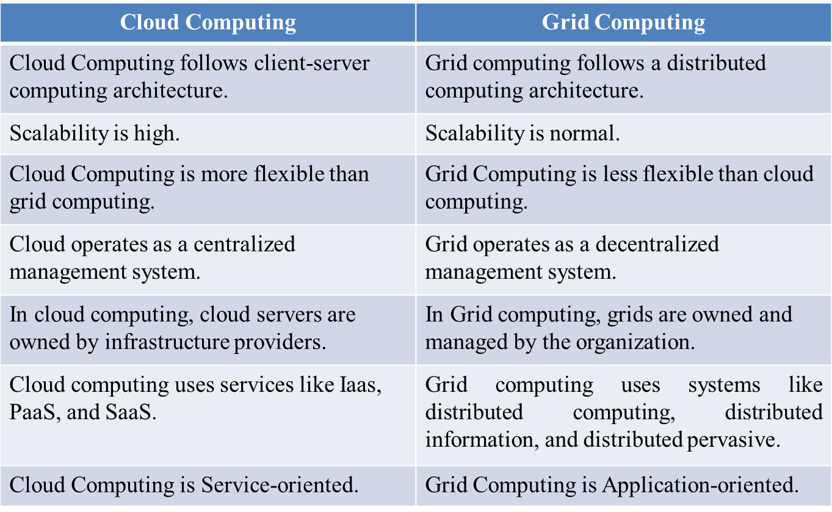
Cloud Vs Grid Computing

Slide 11
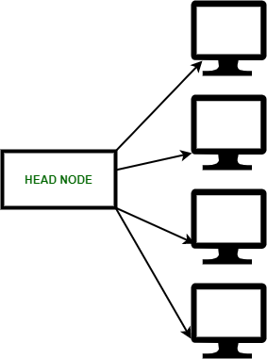
Cluster Computing
Cluster computing is a collection of tightly or loosely connected computers that work together so that they act as a single entity. The connected computers execute operations all together thus creating the idea of a single system. The clusters are generally connected through fast local area networks (LANs).
Why it is important?
Cluster computing gives a relatively inexpensive, unconventional to the large server or mainframe computer solutions.
It resolves the demand for content criticality and process services in a faster way.
Many organizations and IT companies are implementing cluster computing to augment their scalability, availability, processing speed and resource management at economic prices.
It ensures that computational power is always available.
It provides a single general strategy for the implementation and application of parallel high-performance systems independent of certain hardware vendors and their product decisions.

Slide 12
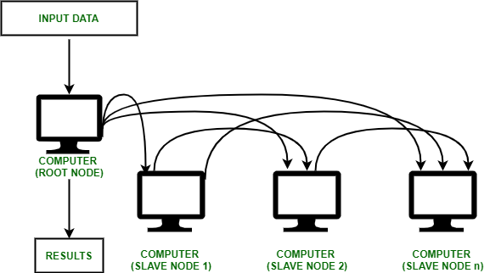
Cluster Computing
Advantages:
High Performance: The systems offer better and enhanced performance than that of mainframe computer networks.
Easy to manage: Cluster Computing is manageable and easy to implement.
Scalable: Resources can be added to the clusters accordingly.
Expandability: Computer clusters can be expanded easily by adding additional computers to the network. Cluster computing is capable of combining several additional resources or the networks to the existing computer system.

Slide 13
Cluster Computing
Disadvantages:
High cost: It is not so much cost-effective due to its high hardware and its design.
Problem in finding fault: It is difficult to find which component has a fault.
More space is needed: Infrastructure may increase as more servers are needed to manage and monitor.
Application:
Various complex computational problems can be solved.
It can be used in the applications of aerodynamics, astrophysics and in data mining.
Weather forecasting.
Image Rendering.
Various e-commerce applications.
Earthquake Simulation.
Petroleum reservoir simulation.

Slide 14
Cluster | Grid
Connected computers have to be homogeneous which means that they should have a similar kind of OS and hardware. | Connected computers can have dissimilar OS and hardware. They can be either heterogeneous or homogeneous.
All the nodes in this are committed to performing a similar operation and no other operation is allowed to be done | The nodes here allot their unused processing resources for the grid computing network.
Every node is so close to the next one | The nodes can be placed at a far distance from each other
All the nodes in the network are connected through the high-speed LAN connection. | All the nodes in the network are connected either through low-speed buses or via the internet.
They are connected in the format of centralized network topology | The nodes are connected in the format of either distributed or de-centralized network topology
Here, scheduling is managed by the central server | It can also have a server, but each computer performs in its own method
The entire system is with a centralized resource administrator | Each of the computers handles its resources in an independent way
These are tightly connected systems | These are loosely connected systems

Slide 15
Utility Computing
Utility computing plays a significant role in business models and gives a unique service provider to the customer IT services according to pay-per-use methods.
A few IT services are provided to customer storage, software applications, and computing power.
So for any questions and advice required for deployment in the business model, the service providers provide the unit divisions to the company.
As the term “Utility” refers to basic amenities like electricity, water, gas, the basic software requirements for a business model are provided by utility computing.

Slide 16
Utility Computing
How it works?
Utility computing is the same as virtualization because the cumulative amount of web storage space along with calculating power is available to the resources is much the larger amount when compared to the one time-sharing computer. The backend servers are available in multiple amounts which are used to do this kind of possible web server. The concerned web servers are applied in the cluster forms which are developed and then given to lease to end-users. The technique of using one unit computation on the multi web server is known as distributed computing. The working of utility computing is easy and simple. The company pays to other companies for its usage of computing services. It includes usage of a particular computer application or some confidential access to computer processing power, rental of hardware components, and data storage space. It is based on the client requirements and the things which can be offered by utility computing. Utility computing is also offered as a package or bundle of resources.

Slide 17
Utility Computing
Components:
The few components that included in the package of utility computing is computer hardware component, software applications, internet access, and cloud systems.
The computer hardware such as monitors, input devices, servers, CPU and network cables.
The browsing software and web servers provide internet access.
The software applications that execute the huge amount of computer mandatory programs such as communication tools, mailbox, report generation, CRM and other project and process-oriented applications and everything that lies in between the client, company and the end-users. The experts from the industries call this process as software as a service.
Enabling the confidential access to a few processes of a supercomputer. Because few enterprises have substantial computational requirements. The status of the financial company keeps on changing rapidly concerning the updating cycle of the stock market. The normal computers take maximum processing time to retrieve or process the data whereas the supercomputer takes only minimum time to process and execute the information and complete the task as quickly as possible.

Slide 18
Cloud Computing
Cloud computing means storing and accessing the data and programs on remote servers that are hosted on the internet instead of the computer’s hard drive or local server. Cloud computing is also referred to as Internet-based computing.
Define Cloud Computing:
Cloud computing is the delivery of computing services—including servers, storage, databases, networking, software, analytics, and intelligence—over the Internet (“the cloud”) to offer faster innovation, flexible resources, and economies of scale.

Slide 19
Characteristics of Cloud Computing
There are many characteristics of Cloud Computing here are few of them :
On-demand self-services: The Cloud computing services does not require any human administrators, user themselves are able to provision, monitor and manage computing resources as needed.
Broad network access: The Computing services are generally provided over standard networks and heterogeneous devices.
Rapid elasticity: The Computing services should have IT resources that are able to scale out and in quickly and on as needed basis. Whenever the user require services it is provided to him and it is scale out as soon as its requirement gets over.
Resource pooling: The IT resource (e.g., networks, servers, storage, applications, and services) present are shared across multiple applications and occupant in an uncommitted manner. Multiple clients are provided service from a same physical resource.
Multi-tenancy: Cloud computing providers can support multiple tenants (users or organizations) on a single set of shared resources.
Security: Cloud providers invest heavily in security measures to protect their users’ data and ensure the privacy of sensitive information.\

Slide 20
Characteristics of Cloud Computing
Measured service: The resource utilization is tracked for each application and occupant, it will provide both the user and the resource provider with an account of what has been used. This is done for various reasons like monitoring billing and effective use of resource.
Virtualization: Cloud computing providers use virtualization technology to abstract underlying hardware resources and present them as logical resources to users.
Resilient computing: Cloud computing services are typically designed with redundancy and fault tolerance in mind, which ensures high availability and reliability.
Flexible pricing models: Cloud providers offer a variety of pricing models, including pay-per-use, subscription-based, and spot pricing, allowing users to choose the option that best suits their needs.
Automation: Cloud computing services are often highly automated, allowing users to deploy and manage resources with minimal manual intervention.
Sustainability: Cloud providers are increasingly focused on sustainable practices, such as energy-efficient data centers and the use of renewable energy sources, to reduce their environmental impact.

Slide 21
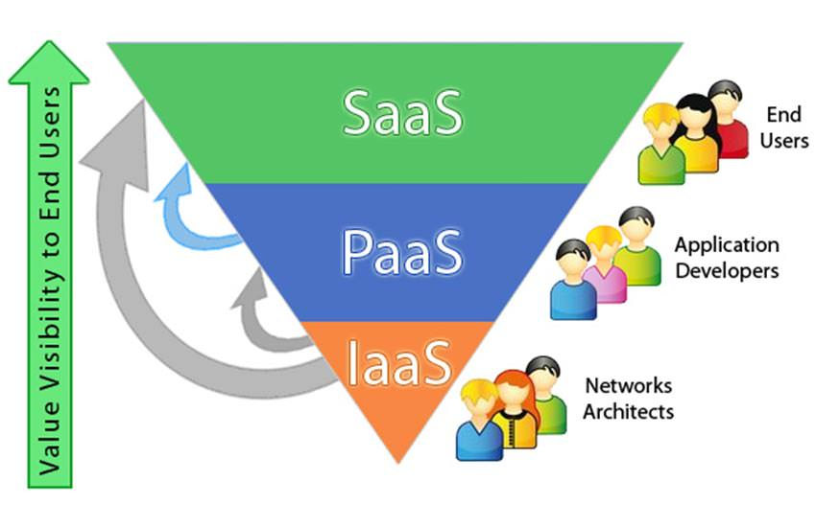
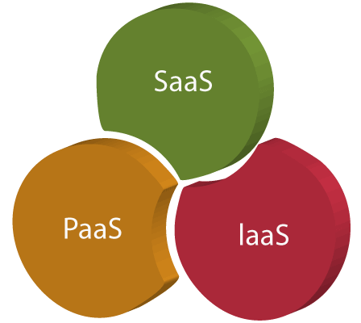
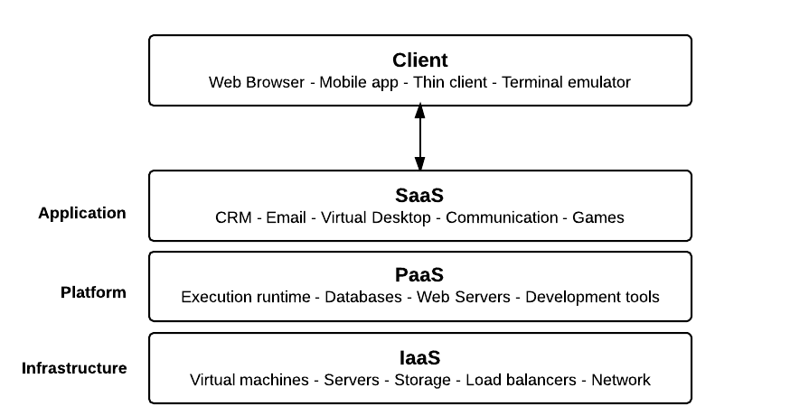
Cloud Service Models
Software as a service (SaaS)
Platform as a service (PaaS)
Infrastructure as a service (IaaS)

Slide 22
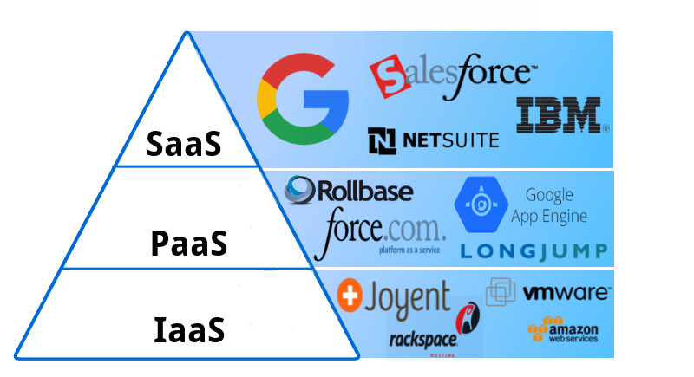
Software as a Service (SaaS)
SaaS is also known as "on-demand software". It is a software in which the applications are hosted by a cloud service provider.
Users can access these applications with the help of internet connection and web browser.
Independent platform and don’t need to install s/w in PC.
Cloud runs single instance of s/w available for multiple end users, making it cheap.
Resources managed by a vendor and accessible via web browser or lightweight client application.
End customers are frequent users of SaaS.
Eg: Google eco system, MS office 365, sales force etc.
Use cases: Netflix, Zoom, Dropbox,

Slide 23
Software as a Service (SaaS)
Advantages:
Universally accessible from any platform
Can work from any where
Excellent for collaborative work
Vendor provides modest s/w tools
Multi-tenancy
Disadvantages:
Portability and browser issues
Performance depend on internet
Compliance restrictions

Slide 24
Platform as a Service (PaaS)
PaaS cloud computing platform is created for the programmer to develop, test, run, and manage the applications
A development environment made up of programming language execution environment, OS, web server and a database.
Users can build, compile and run their programs without worrying of underlying infrastructure.
User manage data and application resources, all other resources managed by vendor.
Eg: AWS elastic beanstalk, google app engine, Windows azure.
Use cases: Mobile application development, cross platform apps, API development and interface, IoT,

Slide 25
Platform as a Service (PaaS)
Advantages:
Cost effective, rapid development and scalable
Faster market for developers
Easy deployment of web applications
Private or public deployment
Disadvantages:
Developers limited to providers languages and tools
Migration issues- vendor lockin

Slide 26
Infrastructure as a Service (IaaS)
IaaS is also known as Hardware as a Service (HaaS). It is a computing infrastructure managed over the internet.
The main advantage of using IaaS is that it helps users to avoid the cost and complexity of purchasing and managing the physical servers.
It offers computing resources and infrastructure in virtual environment.
Resources such as data storage, virtualization, servers and networking.
Vendors are responsible for handling above resources, users responsible for handling application, data, runtime and middleware.
Eg: Mainly for system admins. AWS EC2, GoGrid, Rackspace.com etc.
Use cases: Graphical apps, Web based apps, High performance computers and development process

Slide 27
Infrastructure as a Service (IaaS)
Advantages:
Cloud provides infrastructure.
Enhanced scalability, dynamic work loads.
Flexible.
Disadvantages:
Security issues
Network and service delays

Slide 28
Cloud Deployment Models
Cloud Deployment Model functions as a virtual computing environment with a deployment architecture that varies depending on the amount of data you want to store and who has access to the infrastructure.
Types of Cloud Computing Deployment Models
The cloud deployment model identifies the specific type of cloud environment based on ownership, scale, and access, as well as the cloud’s nature and purpose.
The location of the servers you’re utilizing and who controls them are defined by a cloud deployment model. It specifies how your cloud infrastructure will look, what you can change, and whether you will be given services or will have to create everything yourself.
Relationships between the infrastructure and your users are also defined by cloud deployment types. Different types of cloud computing deployment models are described below.
Public Cloud
Private Cloud
Hybrid Cloud
Community Cloud

Slide 29
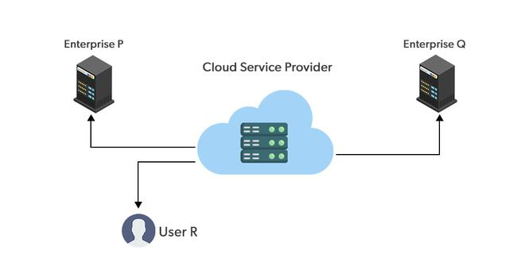
Public Cloud
The public cloud makes it possible for anybody to access systems and services, may be less secure as it is open to everyone.
It is one in which cloud infrastructure services are provided over the internet to the general people or major industry groups.
The infrastructure owned by the entity, not by the consumer.
It is a type of cloud hosting that allows customers and users to easily access systems and services.
Service providers supply services to a variety of customers.
In this arrangement, storage backup and retrieval services are given for free, as a subscription, or on a per-user basis.
Example - Gmail, Dropbox, Microsoft Azure, etc.

Slide 30
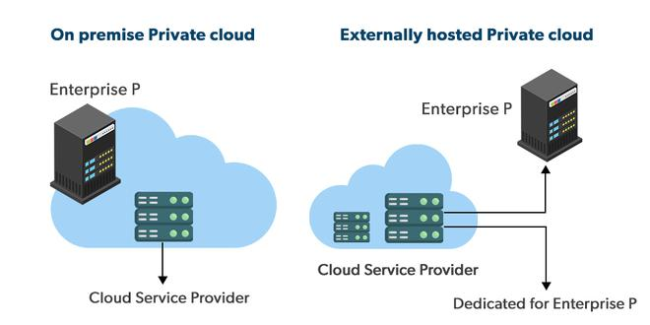
Private Cloud
This is opposite of the public cloud deployment model. It’s a one-on-one environment for a single user (customer).
No need to share your hardware with anyone else. The distinction between private and public clouds is in how you handle all of the hardware.
It is also called the “internal cloud” & it refers to the ability to access systems and services within a given border or organization.
Implemented in a secure environment that is protected by powerful firewalls and under the supervision of an organization’s IT department.
The private cloud gives greater flexibility of control over cloud resources.
Ex: HP Data Centers, Microsoft, Elastra-private cloud, and Ubuntu

Slide 31
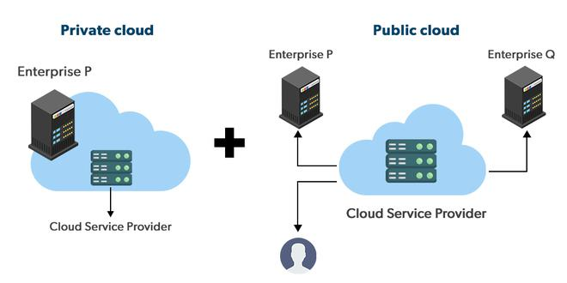
Hybrid Cloud
By bridging the public and private worlds with a layer of proprietary software, hybrid cloud computing gives the best of both worlds.
With a hybrid solution, you may host the app in a safe environment while taking advantage of the public cloud’s cost savings.
Organizations can move data and applications between different clouds using a combination of two or more cloud deployment methods, depending on their needs.
Ex: A large company maintaining a hybrid cloud of public and private.

Slide 32
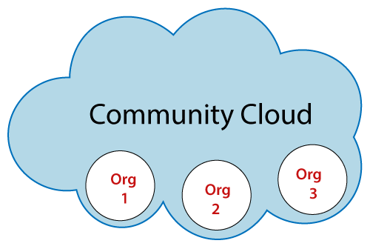
Community Cloud
It is a model between public and private cloud.
Only selected organizations or communities of users having the same line of business or same agenda have access to this type of cloud.
Example: All the banks maintaining a common cloud having the database of loan defaulters, which is shared among the banks to refer while issuing a fresh loan.

Slide 33
Advantages & Disadvantages of cloud computing
Advantages:
Cost Reduction: The major reason companies shift towards cloud computing is that it takes lower costs. The business does not need to build its own IT infrastructure or purchase hardware or equipment. Costs include physical hardware for data storage purposes like hard drives, solid-state drives or disks, etc.
Better Collaboration: Cloud computing allows people to access cloud data from any device, from anywhere, from any time as long as they have an internet connection.
Backup and Restore Data: As the data is stored in the cloud, it is a lot easier to get the backup and recovery of that data with just a few clicks; otherwise, very time-consuming process on-premise, manually.
Security: Due to different security reasons, cloud providers have designed very high-security cloud features so that you can allow what data is accessible to which person groups. Cloud providers also hire top security experts and develop the most advanced security solutions, providing robust protection.

Slide 34
Advantages & Disadvantages
Advantages:
Pay as you go: Cloud computing allows you flexibility because you have to pay only for what you use as a service.
Boundless storage capacity: No storage capacity is predefined, so you can increase or decrease storage capacity according to your needs at any time.
Accessibility: Cloud computing allows you to quickly and easily store, access, and manipulate information on the cloud.
Mobility: Cloud computing allows easy access to all cloud data via mobile through the internet.
Quicker Deployments: Deploy our services to the cloud more quickly and with fewer clicks. As compared to setting up all the configurations on the normal deployments.
Automatic Software Integrations: Set automation of software updates and upgrades. So as soon as a newer version of any software is released, it will automatically integrate into the services you are using.

Slide 35
Advantages & Disadvantages
Disadvantages:
Internet Connectivity: Data (files, images, video, audio, etc.) is stored in the cloud. So to access the data, an internet connection is required. In the absence of the internet, we can't access it.
Downtime: We can't access the data if there is downtime (internet loss at the cloud provider's end).
Vendor lock-in: When transferring all the data from one cloud provider to another, there can be many issues, such as the different cloud providers using different platforms, hosting, and running of the applications on the different platforms that can result in configuration and complexities issues.
Limited Bandwidth: As the Cloud provider provides limited bandwidth to all its users, you have to pay significantly higher costs if your organization surpasses that limit.
Security: Even though the cloud providers are storing information very securely, we still don't have to forget that data is vulnerable to cyber-attacks when stored in the cloud.

Slide 36
Advantages & Disadvantages
Disadvantages:
Performance Variation: As the server is hosted on a cloud provider, which also provides services to other businesses, any cyber attack on shared resources may slow down your services.
Lack of support staff: Some cloud companies do not provide proper support to their clients; then, you have to only depend on FAQs or online help.
Limited Control and Flexibility: The cloud infrastructure is completely owned, managed, and monitored by the cloud providers. So businesses using cloud computing have limited control over their data, applications, and services.
Technical issues: Due to frequent version releases of some applications, you have to constantly upgrade your systems to meet a market need; in between these updates, there is a chance that you may be stuck on some technical problems.

Slide 37
Cloud Base Applications
Adobe Creative Cloud: It is made for designers, artists, filmmakers, and other creative professionals. It is a suite of apps which includes PhotoShop image editing programming, Illustrator, InDesign, TypeKit, Dreamweaver, XD, and Audition.
MailChimp: It offers an e-mail publishing platform. It is widely employed by the businesses to design and send their e-mail campaigns.
Chatter: Chatter app helps the employee to share important information about organization in real time. One can get the instant feed regarding any issue.
Google Apps for Business: Google offers creating text documents, spreadsheets, presentations, etc., on Google Docs which allows the business users to share them in collaborating manner.
Quickbooks: It offers online accounting solutions for a business. It helps in monitoring cash flow, creating VAT returns and creating business reports.

Slide 38
Cloud Base Applications
Paypal: Paypal offers the simplest and easiest online payment mode using a secure internet account. Paypal accepts the payment through debit cards, credit cards, and also from Paypal account holders.
Education: Cloud computing offers various online distance learning platforms and student information portals to the students. Google apps, chrome book etc.
Entertainment: Entertainment industries use a multi-cloud strategy to interact with the target audience. Cloud computing offers various entertainment applications such as online games and video conferencing.
Social applications: Social cloud applications allow a large number of users to connect with each other using social networking applications such as Facebook, Twitter, Linkedln, etc

Slide 39
The Internet of Things
• An Overview - IoT Reference model and Architecture
• The Things in IoT : Sensors and Actuators
• Sensor fundamentals and characteristics–Principles of sensing capacitance-magnetic and electromagnetic induction–resistance- piezoelectric effect–heat transfer- light.
• Applications of IOT and Sensors.

Slide 40
Overview of IOT
Internet of Things is the network of physical objects or ‘things’ embedded with electronics, software, sensors and connectivity to enable it to achieve greater value and service by exchanging data with the manufacturer, operator and/or other connected devices. Each thing is uniquely identifiable through its embedded computing system but is able to interoperate within the existing Internet infrastructure.
The concept of IoT began with things classified as identity communication devices. Radio Frequency Identification Device (RFID) is an example of an identity communication device.
Things are tagged to these devices for their identification in future and can be tracked, controlled and monitored using remote computers connected through the Internet.
Other examples: GPS-based tracking, controlling and monitoring of devices; machine-to-machine (M2M) communication; connected cars; communication between wearable and personal devices and Industry 4.0.
The IoT concept has made smart cities a reality and is also made self-driving cars functional.

Slide 41
Overview of IOT
Technology behind IoT:
Hardware (Arduino Raspberry Pi, Intel Galileo, Intel Edison, ARM mBed, Bosch XDK110, Beagle Bone Black and Wireless SoC)
Integrated Development Environment (IDE) for developing device software, firmware and APIs
Protocols [RPL, CoAP, RESTful HTTP, MQTT, XMPP (Extensible Messaging and Presence Protocol)]
Communication (Powerline Ethernet, RFID, NFC, 6LowPAN, UWB, ZigBee, Bluetooth, WiFi, WiMax, 2G/3G/4G)
Network backbone (IPv4, IPv6, UDP and 6LowPAN)
Software (RIOT OS, Contiki OS, Thingsquare Mist firmware, Eclipse IoT)
Internetwork Cloud Platforms/Data Centre (Sense, ThingWorx, Nimbits, Xively, openHAB, AWS IoT, IBM BlueMix, CISCO IoT, IOx and Fog, EvryThng, Azure, TCS CUP)
Machine learning algorithms and software.

Slide 42

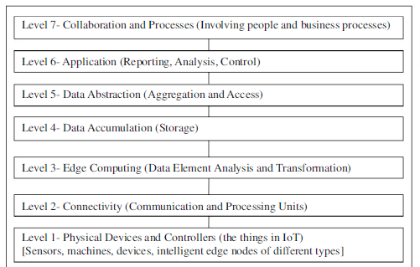
IOT reference model
IoT reference model:

Slide 43
IOT reference model
IoT reference model:
Sensors: There’s virtually no end to the type of sensor that may be required for various projects, the choices are wide open.
Network: The primary job of any network is to transfer data, route data traffic and manage throughput.
Edge: check the data as it comes across and acts upon it where defined.
Storage: The Cloud is often assumed with IoT projects, but sometimes it should be on premises.
Data abstraction: collects different data pieces and makes them available for analysis.
Application: identify which results are reactive, proactive and predictive.
Collaboration and process: the groups that could benefit from the data and services of IoT.

Slide 44
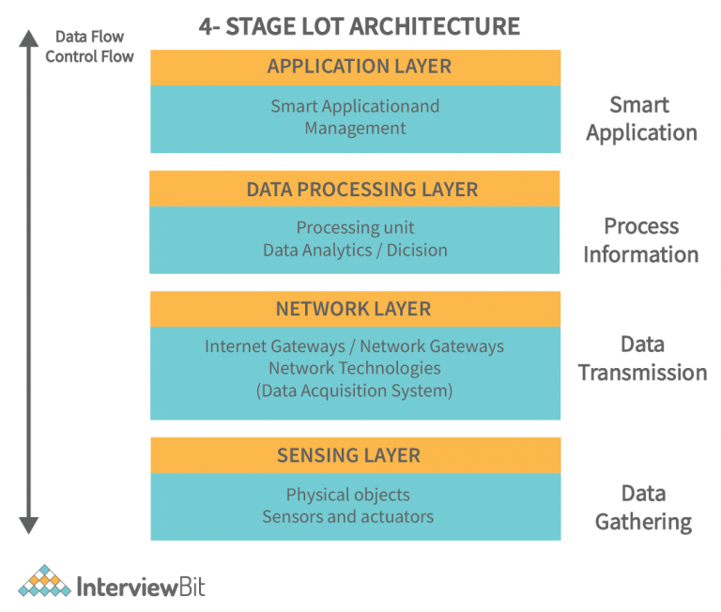
IOT architecture
Sensing layer: Things (sensors & actuators) or endpoint devices are capable of collecting, accepting, and processing data over the network.
Network layer: contains Data Acquiring Systems (DAS) ((collecting and aggregating data from sensors, then converting analog data to digital data, etc.) and Internet/Network gateways.
Processing layer: brain of IoT. data is analyzed, pre-processed, and stored then sent to the data center, accessed by software applications,
Application layer: User interaction takes place at the application layer, which delivers application-specific services to the user.

Slide 45
The things in IOT: Sensors and Actuators
Sensors:
A sensor is a device (typically electronic) that detects events or changes in its physical environment (e.g., temperature, sound, heat, pressure, flow, magnetism, motion, chemical and biochemical parameters) and provides a corresponding output.
Most sensors take analog inputs and deliver digital, often electrical, outputs.
Sensors are comparable to the human five senses.
Sensors typically collect data using physical interfaces (inputs) that sense the environment and then convert input signals into electrical signals (outputs) that are understood by the communication and computing devices.
Output signals are then processed by the gateways and/or by applications of the IoT Platform.

Slide 46
The things in IOT: Sensors and Actuators
Types of Sensors:
Temperature sensors: Thermocouples, Resistance temperature detectors, Thermistors and semi conductor sensor.
Pressure sensors: measure the pressure of gases or liquids including water level, flow, speed, and altitude. Eg. Touchscreen smartphones.
Flow sensors: to detect and record the rate of fluid flow in a pipe.
Level sensors: to measure the level of fluids continuously or at point values.
Imaging sensors: used in digital cameras, medical imaging machines, and night vision equipment.
Noise sensors: to detect noise pollution.
Air pollution sensors: to monitor air pollution.
Proximity & Displacement sensors: presence of objects using EM, light or sound.
Infrared sensors: heat based motion monitoring.
Moisture and humidity: hygrometer sensors-humidity in air.
Speed sensor: speed of vehicles. Eg: wheel speed sensors, speedometers, Doppler radar, and laser surface velocimeter.

Slide 47
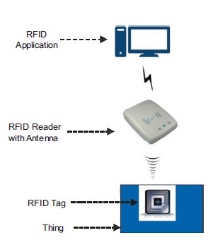
The things in IOT: Sensors and Actuators
Characteristics of Sensors:
Data Filtering
Minimum Power Consumption
Compact
Smart detection
High sensitivity: small change in o/p to i/p.
Linearity: o/p to i/p linear relation.
Dynamic range: range of signals converted to electrical signals by sensor.
Accuracy: maximum expected error b/w measured and ideal.
Hysterisis: sensor does not return the same output value when the input stimulus is driven up or down
Limited noise: filter out noise
Wide bandwidth: The bandwidth of a sensor is the frequency range between the instantaneous change to decay time.
High resolution: smallest detectable signal fluctuation.
Minimum interruption
Higher reliability
Ease of use

Slide 48
The things in IOT: Sensors and Actuators
Actuators:
An actuator is a type of motor that is responsible for controlling or taking action in a system. It takes a source of data or energy (e.g., hydraulic fluid pressure, other sources of power) and converts the data/energy to motion to control a system.
Actuators use sensor-collected and analyzed data as well as other types of data intelligence to control IoT systems.
Types of Actuators:
Electrical Actuators: small motors that convert energy to mechanical torque.
Mechanical Linear Actuators: convert rotary motion to linear motion. Eg. Screw.
Hydraulic Actuators: hydraulic power to mechanical process. linear, rotary, or oscillatory motion.
Pneumatic actuators: similar to hydraulic, but use compressed gas.
Manual actuators: employs levers, gears, or wheels to enable movement.

Slide 49
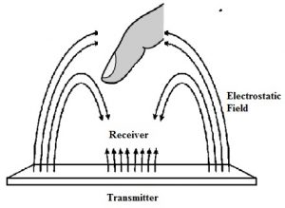
Sensor fundamentals and characteristics
Principles of sensing: capacitance, magnetic and electromagnetic induction, resistance, piezoelectric effect, heat transfer, light.
Capacitance:
It is mainly based on the capacitive coupling principle.
This sensor can simply detect & measure different things like motion, chemical composition, displacement, electric field & indirectly detect many other variables which can be changed into dielectric constant or motion like acceleration, pressure, fluid composition & fluid level.
A capacitive sensor works like a normal capacitor. In this sensor, a metal plate within the sensing face is electrically connected to an oscillator circuit and the target which is detected can act as the next plate of the capacitor.
Capacitive sensor generates an electrostatic field.

Slide 50
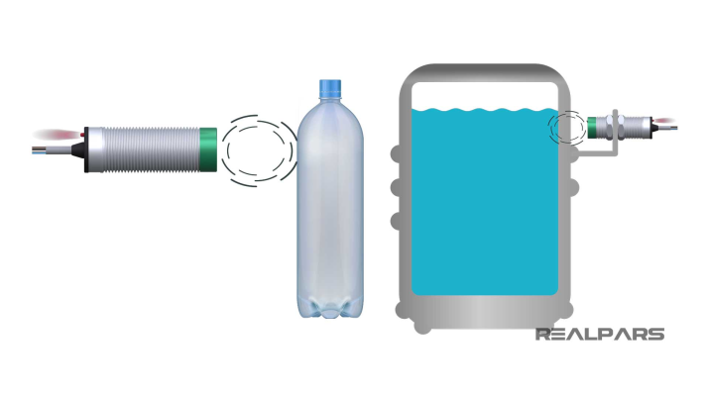
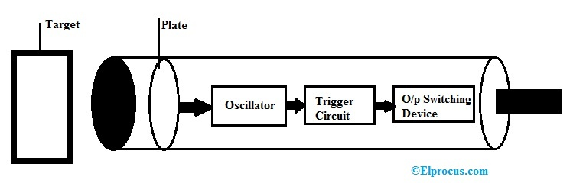
Sensor fundamentals and characteristics
Capacitance:
Consequently, the oscillator circuit will begin to oscillate & change the sensor’s output condition once it arrives at a certain amplitude.
Once the target goes away from the capacitive sensor, the amplitude of the oscillator will reduce, switching the capacitive sensor back to its original position.
Range from 1 inch to 2 inches.
These sensors detect the superior dielectric constant of an object simply.
So, this makes achievable the detection of the material within nonmetallic containers because the dielectric constant of liquid is much higher as compared to the container.

Slide 51
Sensor fundamentals and characteristics
Magnetic:
Magnetic sensor definition is a sensor which is used to notice disturbances as well as changes within a magnetic field such as strength, direction, and flux.
There are different types of detection sensors which can work on some of the characteristics like light, pressure, temperature.
These sensors are separated into two groups. The first one is used to calculate the total magnetic field, whereas the second one is used to calculate vector components of the field.
The magnetic sensor comprises a chip with a magnetoresistive component which is used to detect a magnetic vector & a magnet intended for magnetic vector biasing which can be detected by the magnetoresistive component.

Slide 52
Sensor fundamentals and characteristics
Magnetic:
The chip which is used in the sensor can be used for sensing the change within the magnetic vector. This vector notices the behavior of a magnetic body depending on a change of resistance value of the magnetoresistive component.
Whenever the magnetic vector biasing is occurred due to the magnet in co-operation by the magnetic body, then it will be the motion inside the sensing chip. This sensor can be used to compass functionality, which is accessible during Navigation menu.

Slide 53
Sensor fundamentals and characteristics
Electromagnetic induction (inductive sensors):
Inductive sensor is an essential component used in machines. These sensors are robust devices and mainly designed depending on the requirements of the proximity sensor.
These sensors detect conductive otherwise metallic parts where contact is difficult. These sensors are used in hygiene based and outdoor applications.
They are multi-voltage and high-temperature sensors in non-contact way hence not subjected to mechanical wear and tear.
The working principle of an inductive sensor mainly depends on the electromagnetic induction principle for detecting or measuring objects.
Inductive sensor mainly includes an induction loop which is enough for detecting electromagnetic.
The working of these sensors can be done by generating an oscillating electromagnetic field which is formed by a magnetic object when it is in motion.

Slide 54
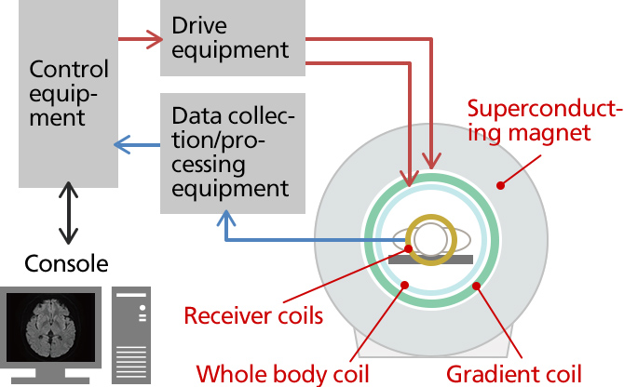
Sensor fundamentals and characteristics
Electromagnetic induction (inductive sensors):
The moving object activates the current flow within the induction loop likewise with Faraday’s law of induction.
So that changes will have occurred within the electromagnetic field. So it can be detected with the circuit of sensors.
A suitable signal can be an output when a magnetic metal is noticed.
Applications:
Proximity, medical MRI, transformer and coil, traffic sensors and moving car, metal detectors, speed detection

Slide 55
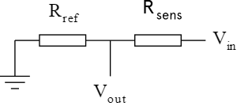
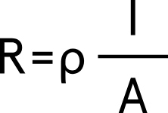
Sensor fundamentals and characteristics
Resistance:
A resistive sensor is a transducer or electromechanical device that converts a mechanical change such as displacement into an electrical signal that can be monitored after conditioning.
Thermistors, photoresistors, and potentiometers are some examples of common resistive sensors.
Resistive sensing is based on the concept of electrical resistance, which in simple terms means how easily electric charges can move through a component in an electric circuit.
This depends in both the geometrical dimensions as well as the material of the component.
Therefore the resistance can be described with the formula
Where ρ is the specific electric resistance of the material, l is the length of the component and A is the cross-section area of the component.

Slide 56
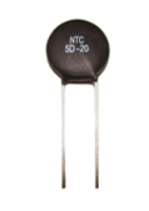
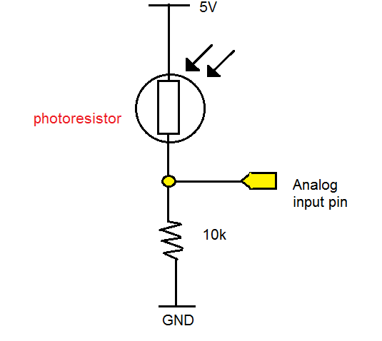
Sensor fundamentals and characteristics
Resistance:
Changing any of these quantities will change the electrical resistance of the components, changing the specific electric resistance is technically difficult.
When force is applied on a force-sensing resistor the contact area between the sensing layer and the electrodes increases or decreases directly proportional to the force, which therefore increases or decreases A in the formula.
Photoresistor: resistance decreases as the light incident on the face of the photoresistor increases.
Thermistor: semiconductor material- small change in temperature, large change in resistance.

Slide 57
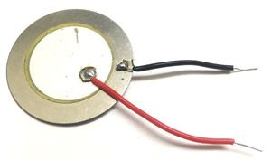
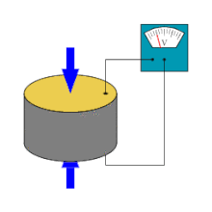
Sensor fundamentals and characteristics
Piezoelectric effect:
Piezoelectricity or piezoelectric effect is the charge created across certain materials when a mechanical stress is applied.
A piezoelectric sensor is a device that uses the piezoelectric effect to measure changes in pressure, acceleration, temperature, strain, or force by converting them to an electrical charge.
When a force is applied to a piezoelectric material, an electric charge is generated across the faces of the crystal. This can be measured as a voltage proportional to the pressure (see diagram to the right).
used for measuring dynamic pressure, for example in turbulence, blast, and engine combustion. These all require fast response, ruggedness and a wide range of operation.
Medical applications. Eg. a thin-film plastic sensor can be attached to the skin and used for real-time monitoring of the arterial pulse.

Slide 58
Sensor fundamentals and characteristics
Heat transfer:
Heat transfer is perhaps the most commonly measured conservational quantity. This is anticipated since most physical, electronic, chemical, mechanical, and biological systems are affected by temperature.
There are four types of temperature sensors:
Thermocouple Sensors: A thermocouple is a device consisting of two different and dissimilar conductors in contact. It produces a voltage as a result of the thermoelectric effect. Thermocouple sensor is made by joining two dissimilar metals at one end.
Resistance Temperature Detector (RTD) Sensors: RTDs are temperature sensing devices whose resistance changes with temperature. They have been used for many years to measure temperature in laboratory and industrial processes and have developed a reputation for accuracy, repeatability, and stability.

Slide 59
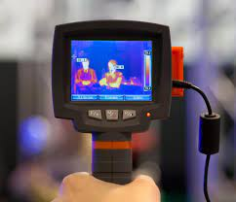
Sensor fundamentals and characteristics
Heat transfer:
Thermistors: Similar to the RTD, the thermistor is a temperature sensing device whose resistance changes with temperature. Thermistors, however, are made from semiconductor materials. Resistance is determined in the same manner as the RTD, but thermistors exhibit a highly nonlinear resistance vs. temperature curve.
Semiconductor Sensors: They are classified into different types like voltage output, current output, digital output, resistance output silicon, and diode temperature sensors. Modern semiconductor temperature sensors offer high accuracy and high linearity over an operating range of about 55 °C to +150 °C (−58 to 302 °F). They can also include signal processing circuitry within the same package as the sensor, thereby avoiding the need to add compensation circuits.

Slide 60
Sensor fundamentals and characteristics
Light:
Light Sensors are photoelectric devices that convert light energy (photons) whether visible or infra-red light into an electrical (electrons) signal.
Light Sensor generates an output signal indicating the intensity of light by measuring the radiant energy that exists in a very narrow range of frequencies basically called “light”, and which ranges in frequency from “Infra-red” to “Visible” up to “Ultraviolet” light spectrum.
The light sensor is a passive devices that convert this “light energy” whether visible or in the infra-red parts of the spectrum into an electrical signal output. Light sensors are more commonly known as “Photoelectric Devices” or “Photo Sensors” because the convert light energy (photons) into electricity (electrons).
Photoelectric devices can be grouped into two main categories, those which generate electricity when illuminated, such as Photo-voltaics or Photo-emissives etc, and those which change their electrical properties in some way such as Photo-resistors or Photo-conductors.

Slide 61
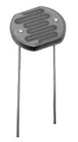
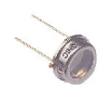
Sensor fundamentals and characteristics
Classification of light sensors:
Photo-emissive Cells: Release free electrons from a light sensitive material such as caesium when struck by a photon of sufficient energy. The higher the frequency, the more energy the photons have converting light energy into electrical energy.
Photo-conductive Cells: Vary their electrical resistance when subjected to light. Photoconductivity results from light hitting a semiconductor material which controls the current flow through it. Thus, more light increase the current for a given applied voltage. The most common photoconductive material is Cadmium Sulphide used in LDR photocells.
Photo-voltaic Cells: Generate an emf in proportion to the radiant light energy received and is similar in effect to photoconductivity. Light energy falls on to two semiconductor materials sandwiched together creating a voltage of approximately 0.5V. The most common photovoltaic material is Selenium used in solar cells.
Photo-junction Devices: Semiconductor devices such as the photodiode or phototransistor which use light to control the flow of electrons and holes across their PN-junction. Designed for detector application and light penetration with their spectral response tuned to the wavelength of incident light.

Slide 62
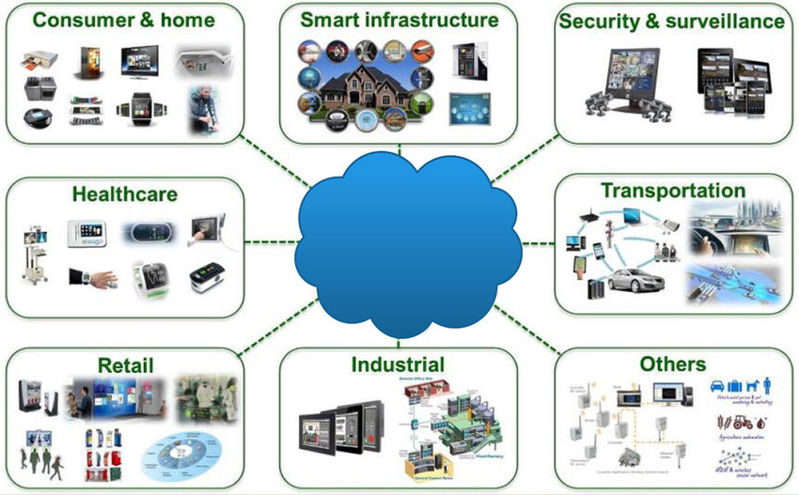
Applications of IOT and Sensors
IoT in Agriculture and Farming: Advanced yield monitoring, Optimal seeding, Optimal water usage and Livestock monitoring.
IoT Energy solutions: Smart meters, Smart homes and smart monitoring of renewable energy sources.
IoT Oil and Gas Solutions: Connected oil and gas fields and downstream applications.

Slide 63
Applications of IOT and Sensors
IoT in Smart Building Solutions: Safety Monitoring and Alerting, Smart Lighting, Flooding, Water Leakage, and Pollution Monitoring and Detection of Hazardous Gases and Radiation Levels.
IoT Finance: IoT Usage-based auto insurance, IoT Solution to reduce Fraud and Liability and IoT Safety Solutions.
IoT Healthcare: Fall Detection, Tracking of medical devices, Medical fridges for hospitals and alerts.
IoT Industrial: Predictive maintenance, Connected Factory, Connected Mine and Supply Chain Control.
IoT Retail: Full Tracking of Products in Stores, Full Automation of Product Delivery, Flexible Shopping and Loyalty Programs, Customer Engagement Suite and Interactive consumer engagement and operations.
IoT Transportation: Smart and Connected Parking, Smart Roads and Traffic Congestion, Connected Rail,

